Slide 1
Chain of Thought Prompting for Large Language Model Reasoning

Slide 2
Hard Language Tasks: Reasoning

Slide 3
Reasoning Problems
Q: If there are 3 cars in the parking lot and 2 more cars arrive, how many cars are in the parking lot?
Q: Take the last letters of the words in "Elon Musk" and concatenate them
Q: What home entertainment equipment requires cable?
Answer Choices: (a) radio shack
(b) substation (c) television (d) cabinet
A: The answer is nk.
A: The answer is 5
A: The answer is (c).
Arithmetic Reasoning (AR)
(+ − ×÷…)
Symbolic Reasoning (SR)
Commonsense Reasoning (CR)

Slide 4
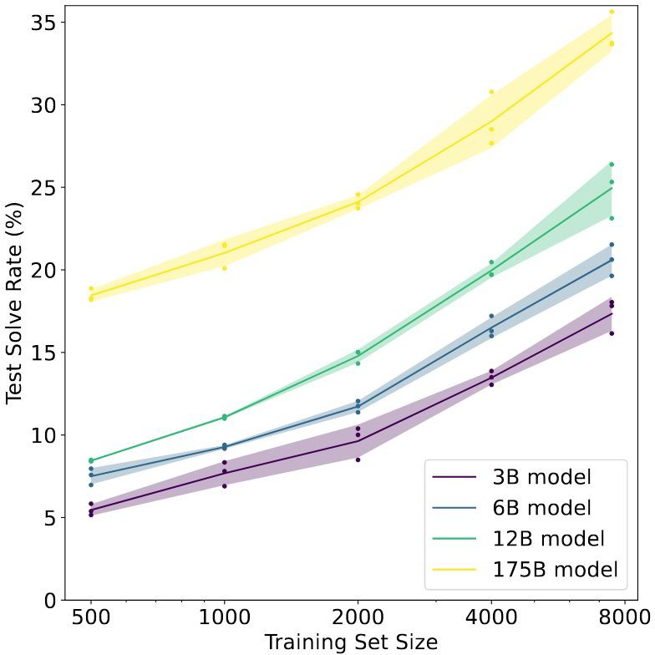
Reasoning Problems
Fine-tune GPT-3 on GSM8K (arithmetic): (Cobbe et al. 2021)
Conjecture: to achieve > 80%, needs 100 times more fine-tuning data for 175B model

Slide 5
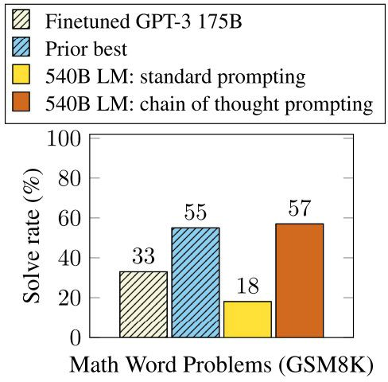
Reasoning Problems
GSM8K (arithmetic):
Few-shot standard prompting with even larger model (PaLM 540B) also does not work well.

Slide 6
Reasoning Problems
Scaling up language model size does not efficiently achieve high performances, for Arithmetic Reasoning (AR), CommonSense Reasoning (CR) and Symbolic Reasoning (SR) tasks.

Slide 7
Reasoning Problems
Scaling up language model size does not efficiently achieve high performances, for Arithmetic Reasoning (AR), CommonSense Reasoning (CR) and Symbolic Reasoning (SR) tasks.
Proposed solution: chain of thought prompting

Slide 8
Chain of Thought Prompting

Slide 9
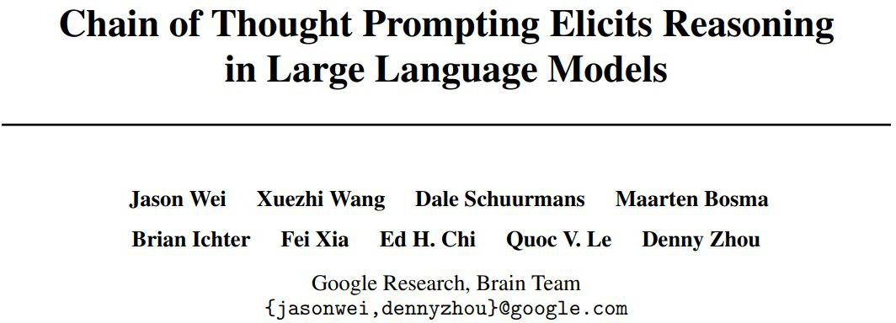
Chain of Thought (CoT)
Few-Shot CoT

Slide 10
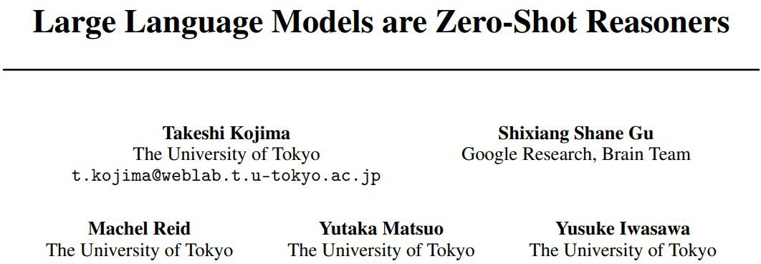
Chain of Thought (CoT)
Few-Shot CoT
Both papers will appear in NeurIPS’22!
Zero-Shot CoT

Slide 11
Chain of Thought (CoT)
Definition:
A chain of thought is a series of intermediate natural language reasoning steps that lead to the final output.

Slide 12
Chain of Thought (CoT)
Definition:
A chain of thought is a series of intermediate natural language reasoning steps that lead to the final output.
Intuition (from neural-symbolic computing):
use <input, intermediate results, output> triples, rather than simple <input, output> pairs

Slide 13
Chain of Thought (CoT)
Definition:
A chain of thought is a series of intermediate natural language reasoning steps that lead to the final output.
Intuition (from neural-symbolic computing):
use <input, intermediate results, output> triples, rather than simple <input, output> pairs
Benefits:
Decomposition -> easier intermediate problems
Interpretable
More general than neural symbolic computing
Leveraging prompting of LLM

Slide 14
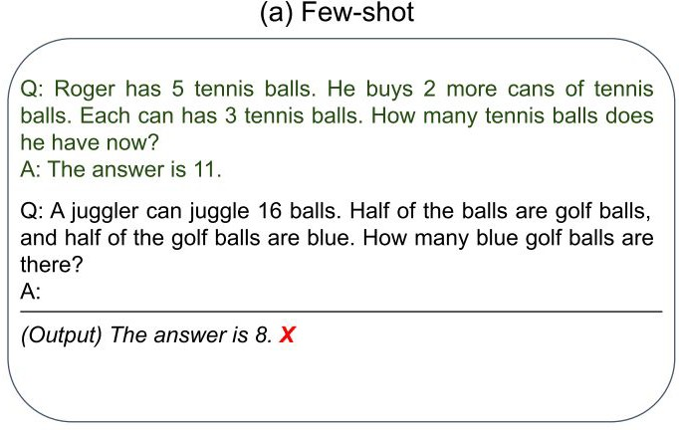
Chain of Thought (CoT)
Examples

Slide 15
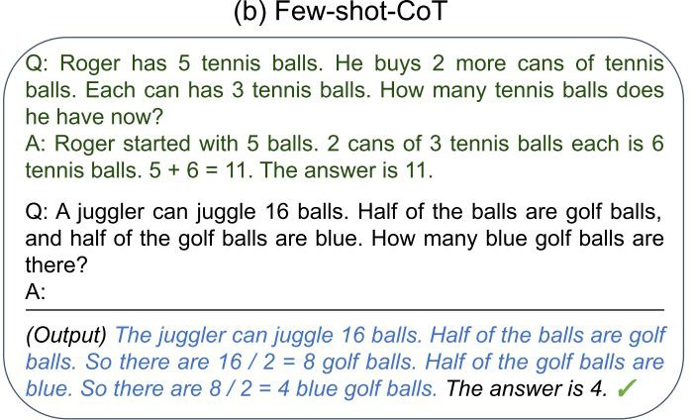
Chain of Thought (CoT)
（Wei et al., 2022）
Examples
CoT Examples
Step-by-step Answer

Slide 16
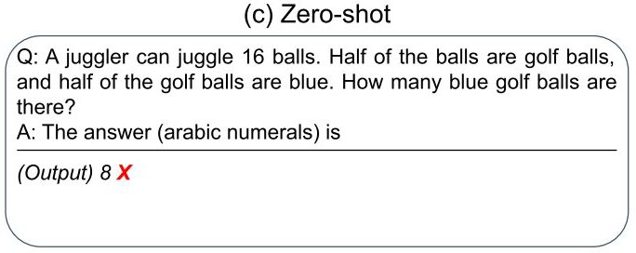
Chain of Thought (CoT)
（Wei et al., 2022）
Examples
CoT Examples
Step-by-step Answer

Slide 17
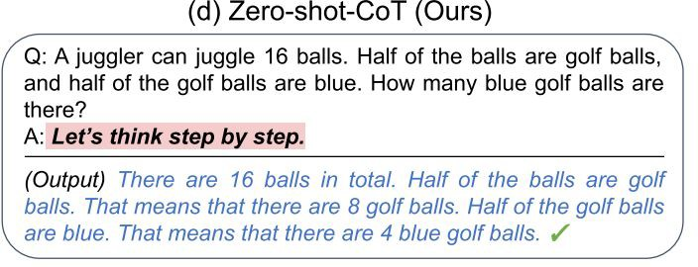
Chain of Thought (CoT)
（Wei et al., 2022）
Examples
CoT Examples
Step-by-step Answer
（KoJima et al., 2022）
Two-stage Prompting Step-by-step Answer

Slide 18
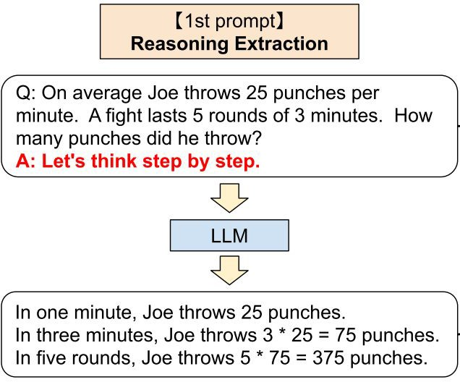
Zero-Shot Chain of Thought (CoT)
For zero-shot CoT, a two-stage prompting is applied:
Question Trigger1
Reasoning Path

Slide 19
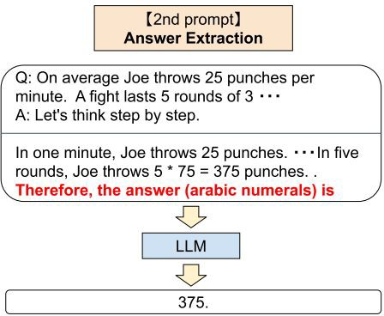

Zero-Shot Chain of Thought (CoT)
For zero-shot CoT, a two-stage prompting is applied:
Question Trigger1
Question
+Trigger1
Reasoning Path Trigger2
Reasoning Path
Answer

Slide 20
Experiments

Slide 21
Models
Pre-trained LLMs:
Instruct GPT-3 (ada 350M, babbage 1.3B, curie 6.7B, and davinci 175B) (Ouyang et al., 2022)

Slide 22
Models
Pre-trained LLMs:
Instruct GPT-3 (ada 350M, babbage 1.3B, curie 6.7B, and davinci 175B) (Ouyang et al., 2022)
Not your familiar GPT-3 (Brown, et al., 2020)
Fine-tuned with human feedback
Stay tuned for the lecture on Nov. 14!!

Slide 23

Models
Pre-trained LLMs:
Instruct GPT-3 (ada 350M, babbage 1.3B, curie 6.7B, and davinci 175B) (Ouyang et al., 2022)
PaLM (8B, 62B, 540B) (Chowdhery et al., 2022)
Only accessible to Googlers .

Slide 24
Models
Pre-trained LLMs:
Instruct GPT-3 (ada 350M, babbage 1.3B, curie 6.7B, and davinci 175B) (Ouyang et al., 2022)
PaLM (8B, 62B, 540B) (Chowdhery et al., 2022)
LaMDA (422M, 2B, 8B, 68B, 137B) (Thoppilan et al., 2022)
Dialogue-oriented LM.
Fine-tuned on human-annotated data.

Slide 25
Models
Pre-trained LLMs:
Instruct GPT-3 (ada 350M, babbage 1.3B, curie 6.7B, and davinci 175B) (Ouyang et al., 2022)
PaLM (8B, 62B, 540B) (Chowdhery et al., 2022)
LaMDA (422M, 2B, 8B, 68B, 137B) (Thoppilan et al., 2022)
GPT-3 (ada 350M, babbage 1.3B, curie 6.7B, davinci 175B)
GPT-2 (1.5B)
GPT-Neo (2.7B), GPT-J (6B), T0 (11B) (Sanh et al., 2022), OPT (13B) (Zhang et al., 2022)

Slide 26
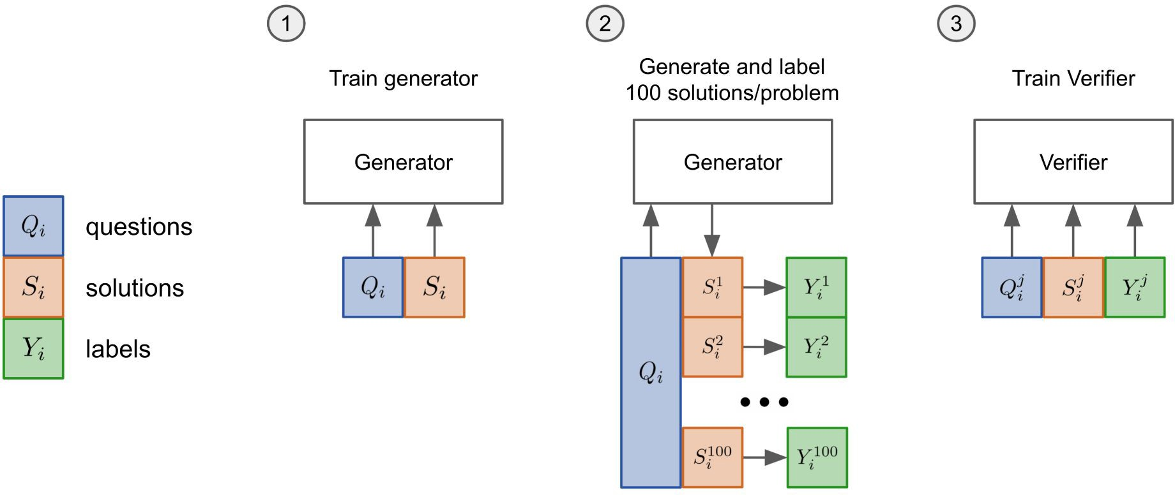
Prior Best – Fine-tuning + Verification
GPT-3
Fine-tuned 2 epoch on training set.
Sample 100 solutions from the generator for each training problem and label each solution as correct or incorrect.
Train a verifier for a single epoch on this dataset.
Correct or Incorrect
(Cobbe et al. 2021)
26

Slide 27
Experiments Arithmetic Reasoning

Slide 28
Free Response - Few-Shot CoT Prompt Exemplar
Free Response
Manually composed 8 exemplars
Q: If there are 3 cars in the parking lot and 2 more cars arrive, how many cars are in the parking lot?
A: There are originally 3 cars. 2 more cars arrive. 3 + 2 = 5. The
answer is 5.
（Wei et al., 2022）

Slide 29
Free Response - Few-Shot CoT Prompt Exemplar
Free Response
Manually composed 8 exemplars
Q: If there are 3 cars in the parking lot and 2 more cars arrive, how many cars are in the parking lot?
All contains equations with flexible formats
A: There are originally 3 cars. 2 more cars arrive. 3 + 2 = 5. The
answer is 5.
（Wei et al., 2022）

Slide 30
Free Response - Few-Shot CoT Prompt Exemplar
Free Response
Free Response
Q: If there are 3 cars in the parking lot and 2 more cars arrive, how many cars are in the parking lot?
Q: Olivia has $23. She bought five bagels for $3 each. How much money does she have left?
A: There are originally 3 cars. 2 more cars arrive. 3 + 2 = 5. The
answer is 5.
A: Olivia had 23 dollars. 5 bagels for 3 dollars each will be 5 x 3 = 15 dollars. So she has 23 - 15 dollars left. 23 - 15 is 8. The answer is 8.
（Wei et al., 2022）
（Wei et al., 2022）
You can have one or more equations.

Slide 31
Free Response - Few-Shot CoT Prompt Exemplar
Free Response
Free Response
Q: If there are 3 cars in the parking lot and 2 more cars arrive, how many cars are in the parking lot?
Q: Olivia has $23. She bought five bagels for $3 each. How much money does she have left?
A: There are originally 3 cars. 2 more cars arrive. 3 + 2 = 5. The
answer is 5.
A: Olivia had 23 dollars. 5 bagels for 3 dollars each will be 5 x 3 = 15 dollars. So she has 23 - 15 dollars left. 23 - 15 is 8. The answer is 8.
（Wei et al., 2022） （Wei et al., 2022）
Equations can be incomplete and combined math with words.

Slide 32
Free Response - Few-Shot CoT Prompt Exemplar
Free Response
Q: If there are 3 cars in the parking lot and 2 more cars arrive, how many cars are in the parking lot?
A: There are originally 3 cars. 2 more cars arrive. 3 + 2 = 5. The
answer is 5.
Manually composed 8 exemplars
All contains equations with flexible formats
Benchmarked on:
GSM8K (Cobbe et al. 2021)
SVAMP (Patel et al., 2021)
MAWPS (Koncel-Kedziorski et al., 2016)
（Wei et al., 2022）

Slide 33
Multiple Choice - Few-Shot CoT Prompt Exemplar
Multiple Choice
4 exemplars, whose questions, intermediate reasoning, and answers are from AQuA-RAT’s training set
Q: A person is traveling at 20 km/hr and reached his destiny in 2.5 hr then find the distance?
Answer Choices: (a) 53 km (b) 55 km (c) 52 km (d) 60 km (e) 50 km
A: The distance that the person traveled would have been 20 km/hr * 2.5 hrs = 50 km. The answer is (e).

Slide 34
Multiple Choice - Few-Shot CoT Prompt Exemplar
Multiple Choice
Multiple Choice
Q: A person is traveling at 20 km/hr and reached his destiny in 2.5 hr then find the distance?
Answer Choices: (a) 53 km (b) 55 km (c) 52 km (d) 60 km (e) 50 km
Q: If a / b = 3/4 and 8a + 5b = 22,then find the value of a.
Answer Choices: (a) 1/2 (b) 3/2 (c) 5/2
(d) 4/2 (e) 7/2
A: If a / b = 3/4, then b = 4a / 3. So 8a + 5(4a / 3) = 22. This simplifies to 8a + 20a / 3 = 22, which means 44a / 3 = 22. So a is equal to 3/2. The answer is (b).
A: The distance that the person traveled would have been 20 km/hr * 2.5 hrs = 50 km. The answer is (e).
The exemplars have various formats.

Slide 35
Multiple Choice - Few-Shot CoT Prompt Exemplar
Multiple Choice
Q: A person is traveling at 20 km/hr and reached his destiny in 2.5 hr then find the distance?
Answer Choices: (a) 53 km (b) 55 km (c) 52 km (d) 60 km (e) 50 km
A: The distance that the person traveled would have been 20 km/hr * 2.5 hrs = 50 km. The answer is (e).
4 exemplars, whose questions, intermediate reasoning, and answers are from AQuA-RAT’s training set
Exemplars have flexible formats

Slide 36
Multiple Choice - Few-Shot CoT Prompt Exemplar
Multiple Choice
Q: A person is traveling at 20 km/hr and reached his destiny in 2.5 hr then find the distance?
Answer Choices: (a) 53 km (b) 55 km (c) 52 km (d) 60 km (e) 50 km
A: The distance that the person traveled would have been 20 km/hr * 2.5 hrs = 50 km. The answer is (e).
4 exemplars, whose questions, intermediate reasoning, and answers are from training set
Exemplars have flexible formats
Benchmarked on AQuA-RAT (Ling et al., 2017)

Slide 37
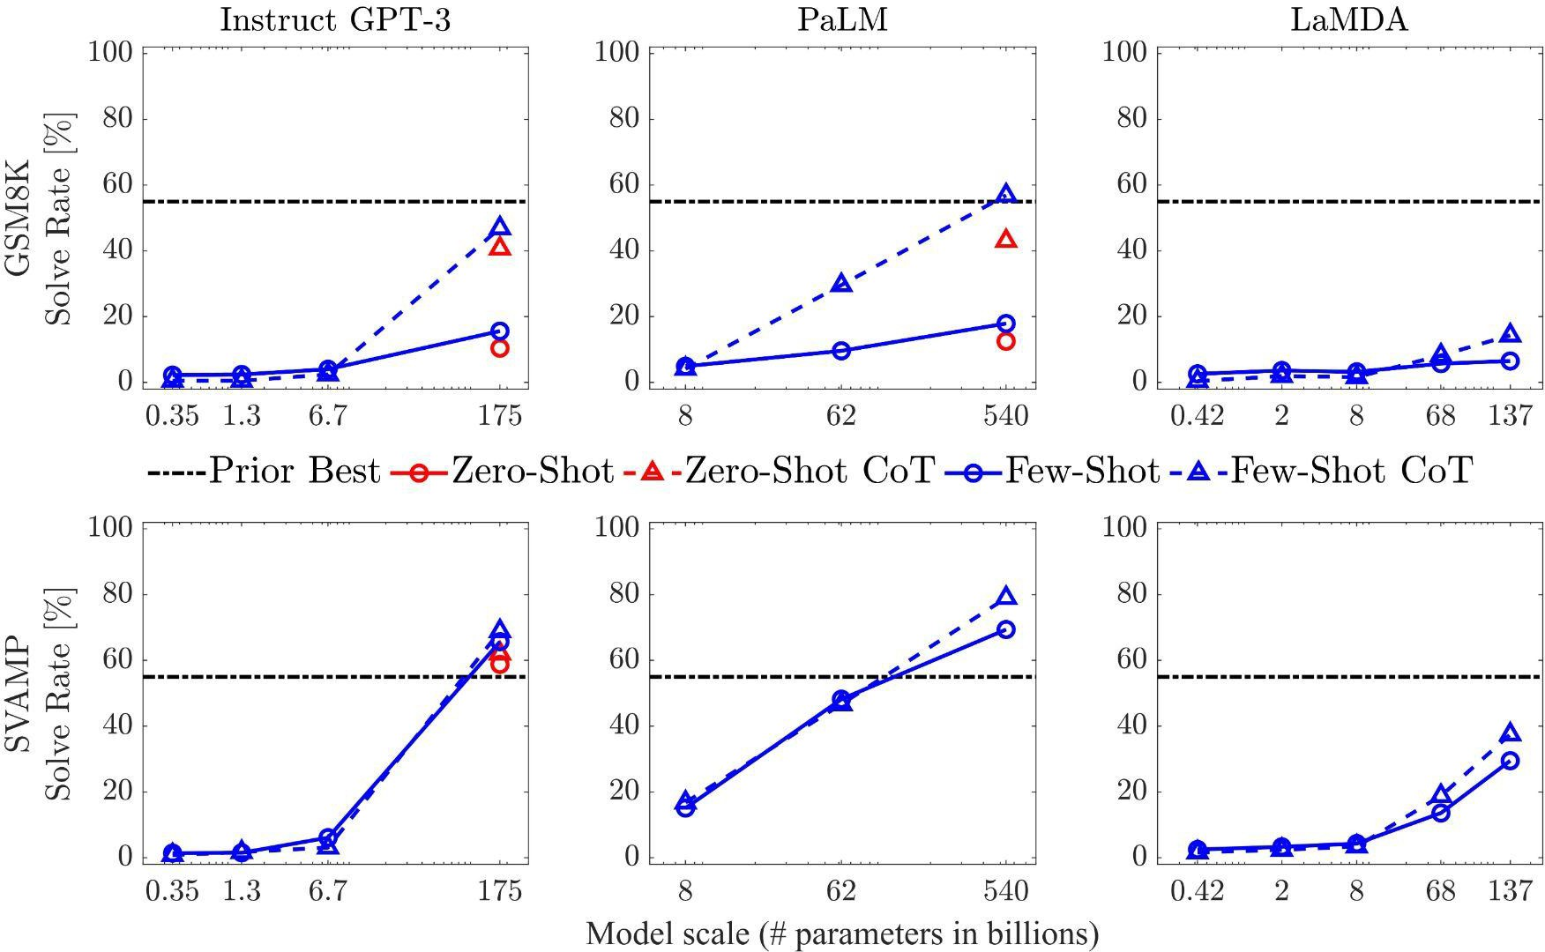
Arithmetic Reasoning - Results
GSM8K
Josh decides to try flipping a house. He buys a house for
$80,000 and then puts in $50,000
in repairs. This increased the value of the house by 150%. How much profit did he make?
SVAMP
Each pack of dvds costs 76 dollars. If there is a discount of 25 dollars on each pack. How much do you have to pay to buy each pack?

Slide 38
Arithmetic Reasoning - Results
GSM8K
Josh decides to try flipping a house. He buys a house for
$80,000 and then puts in $50,000
in repairs. This increased the value of the house by 150%. How much profit did he make?
Fine-tuning + Verification
SVAMP
Each pack of dvds costs 76 dollars. If there is a discount of 25 dollars on each pack. How much do you have to pay to buy each pack?

Slide 39
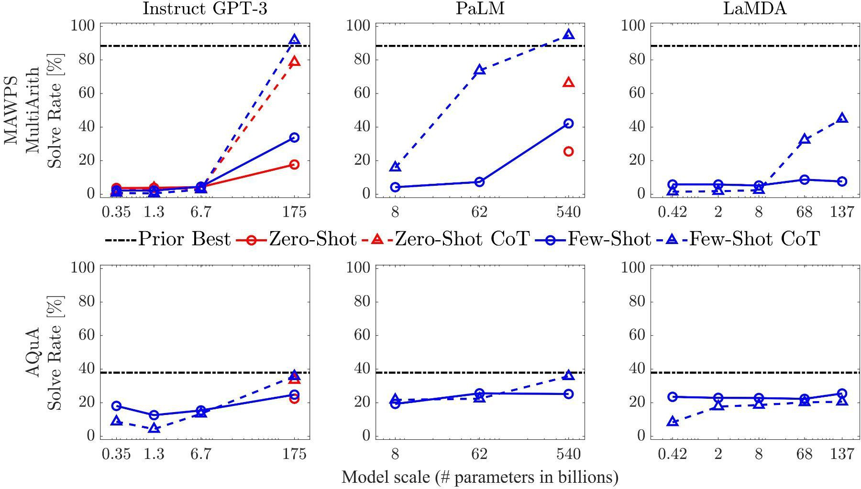
Arithmetic Reasoning - Results
MAWPS - MultiArith The school cafeteria ordered 42 red apples and 7 green apples for students lunches. But, if only 9 students wanted fruit, how many extra did the cafeteria end up with?
AQuA-RAT
A person is traveling at 20 km/hr and reached his destiny in 2.5 hr then find the distance?
Answer Choices: (a) 53 km (b)
55 km (c) 52 km (d) 60 km (e) 50 km

Slide 40
Arithmetic Reasoning - Results
MAWPS - MultiArith The school cafeteria ordered 42 red apples and 7 green apples for students lunches. But, if only 9 students wanted fruit, how many extra did the cafeteria end up with?
AQuA-RAT
A person is traveling at 20 km/hr and reached his destiny in 2.5 hr then find the distance?
Answer Choices: (a) 53 km (b)
55 km (c) 52 km (d) 60 km (e) 50 km

Slide 41
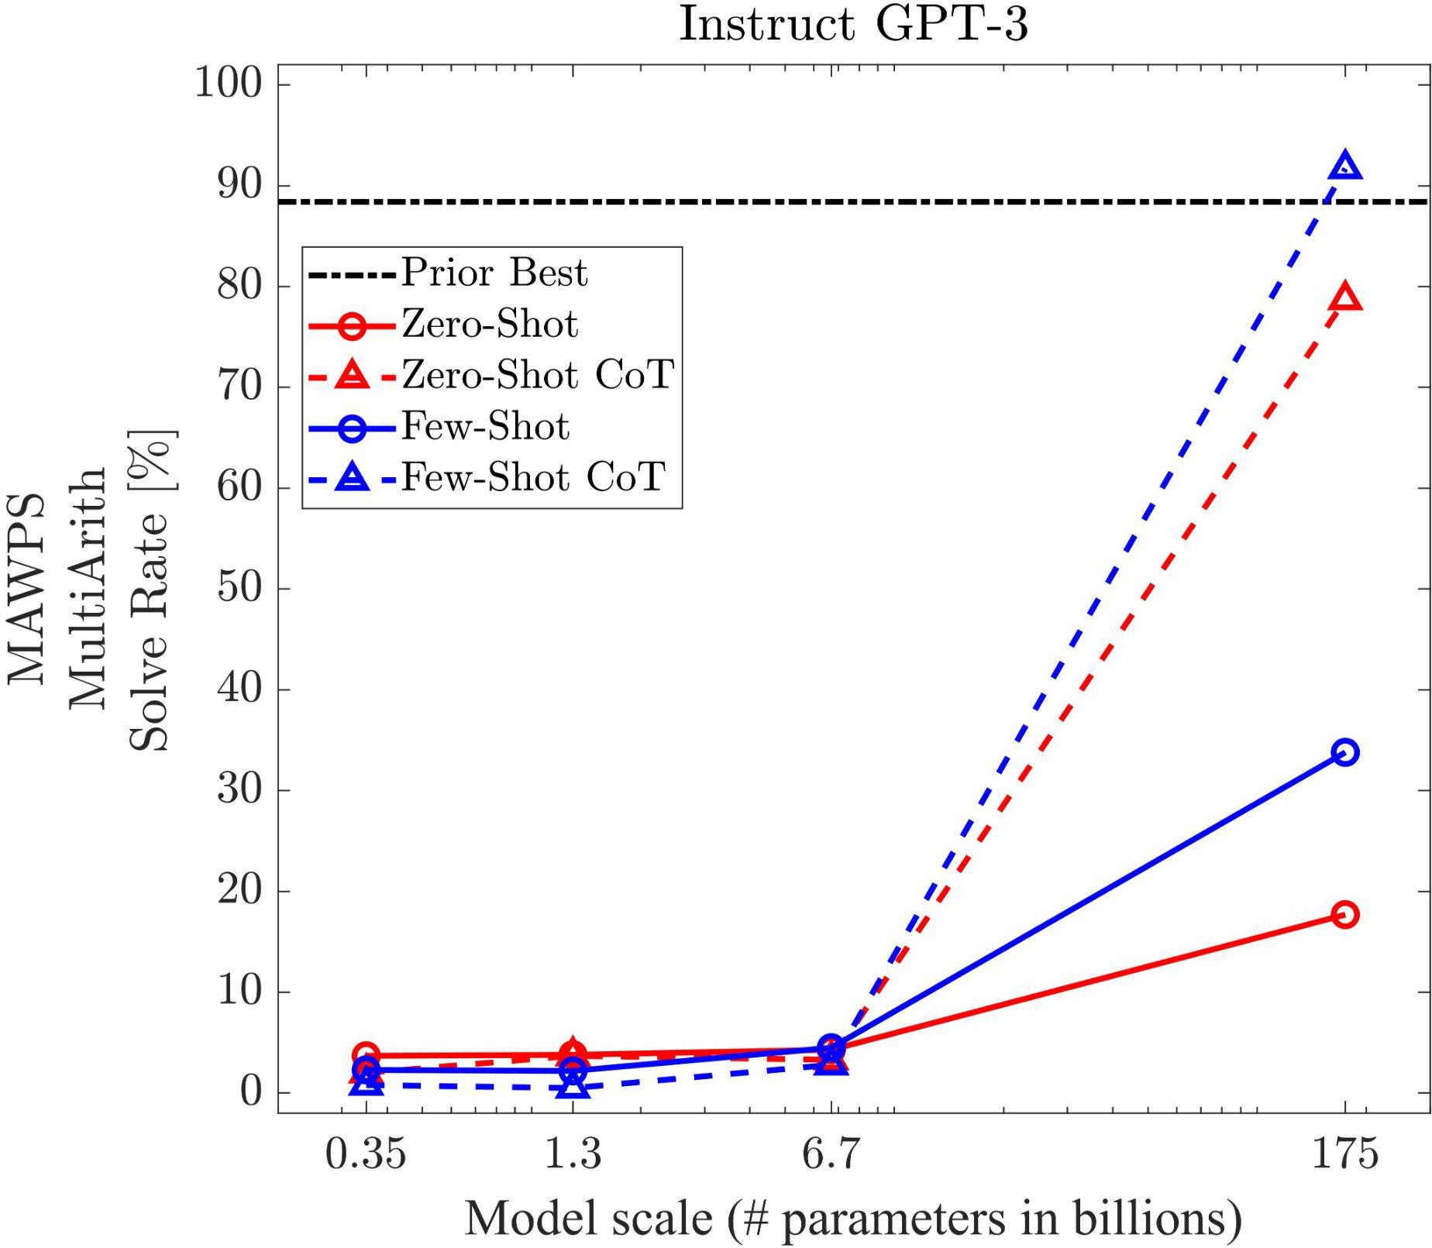
Arithmetic Reasoning - Observations
Both zero-shot and few-shot chain of thought promptings are emergent abilities of model scale.

Slide 42
Arithmetic Reasoning - Observations
Both zero-shot and few-shot chain of thought promptings are emergent abilities of model scale.
They do not positively impact performance for small models, but start to yield performance gains when used with models with more than ∼100B parameters.

Slide 43
Arithmetic Reasoning - Observations
Both zero-shot and few-shot chain of thought promptings are emergent abilities of model scale.
They do not positively impact performance for small models, but start to yield performance gains when used with models with more than ∼100B parameters.
Few-shot CoT achieves better performance on LLM than zero-shot CoT.

Slide 44
Arithmetic Reasoning - Observations
Both zero-shot and few-shot chain of thought promptings are emergent abilities of model scale.
They do not positively impact performance for small models, but start to yield performance gains when used with models with more than ∼100B parameters.
Few-shot CoT achieves better performance on LLM than zero-shot CoT.
Instruct GPT-3: text-davinci-002 achieves similar performance as PaLM 540B model

Slide 45
Experiments Symbolic Reasoning

Slide 46
Symbolic Reasoning - Last Letter Concatenation
Last letter concatenation
Q: Take the last letters of the words in "Elon Musk" and concatenate them
A: The last letter of "Elon" is "n". The last letter of "Musk" is "k".
Concatenating them is "nk". The answer is nk.
Generate full names by randomly concatenating names from the top
one-thousand first and last names from name census data

Slide 47
Symbolic Reasoning - Last Letter Concatenation
Last letter concatenation
Q: Take the last letters of the words in "Elon Musk" and concatenate them
A: The last letter of "Elon" is "n". The last letter of "Musk" is "k".
Concatenating them is "nk". The answer is nk.
Generate full names by randomly concatenating names from the top
one-thousand first and last names from name census data
4 exemplars with strict format

Slide 48
Symbolic Reasoning - Last Letter Concatenation
Last letter concatenation
Q: Take the last letters of the words in "Elon Musk" and concatenate them
A: The last letter of "Elon" is "n". The last letter of "Musk" is "k".
Concatenating them is "nk". The answer is nk.
Last letter concatenation
Q: Take the last letters of the words in "Bill Gates" and concatenate them
A: The last letter of "Bill" is "l". The last letter of "Gates" is "s". Concatenating them is "ls". The answer is ls.

Slide 49
Symbolic Reasoning - Coin Flip
Coin Flip
Coin Flip
Q: A coin is heads up. Tom does not flip the coin. Mike does not flip the coin. Is the coin still heads up?
Q: A coin is heads up. Jamey flips the coin. Teressa flips the coin. Is the coin still heads up?
A: The coin was flipped by no one. So the coin was flipped 0 times. The coin started heads up, and it was not flipped, so it is still heads up. So the answer is yes.
A: The coin was flipped by Jamey and Teressa. So the coin was flipped 2 times, which is an even number. The coin started heads up, so after an even number of flips, it will still be heads up. So the answer is yes.
8 exemplars with strict format.

Slide 50
Symbolic Reasoning - In & Out-of-domain Test
Last letter concatenation
Coin Flip
Q: Take the last letters of the words in "Elon Musk" and concatenate them
Q: A coin is heads up. Tom does not flip the coin. Mike does not flip the coin. Is the coin still heads up?
A: The last letter of "Elon" is "n". The last letter of "Musk" is "k".
Concatenating them is "nk". The answer is nk.
A: The coin was flipped by no one. So the coin was flipped 0 times. The coin started heads up, and it was not flipped, so it is still heads up. So the answer is yes.
In-domain test set: examples had the same number of steps as the few-shot exemplars
Out-of-domain (OOD) test set: examples had more steps than those in the exemplars.

Slide 51
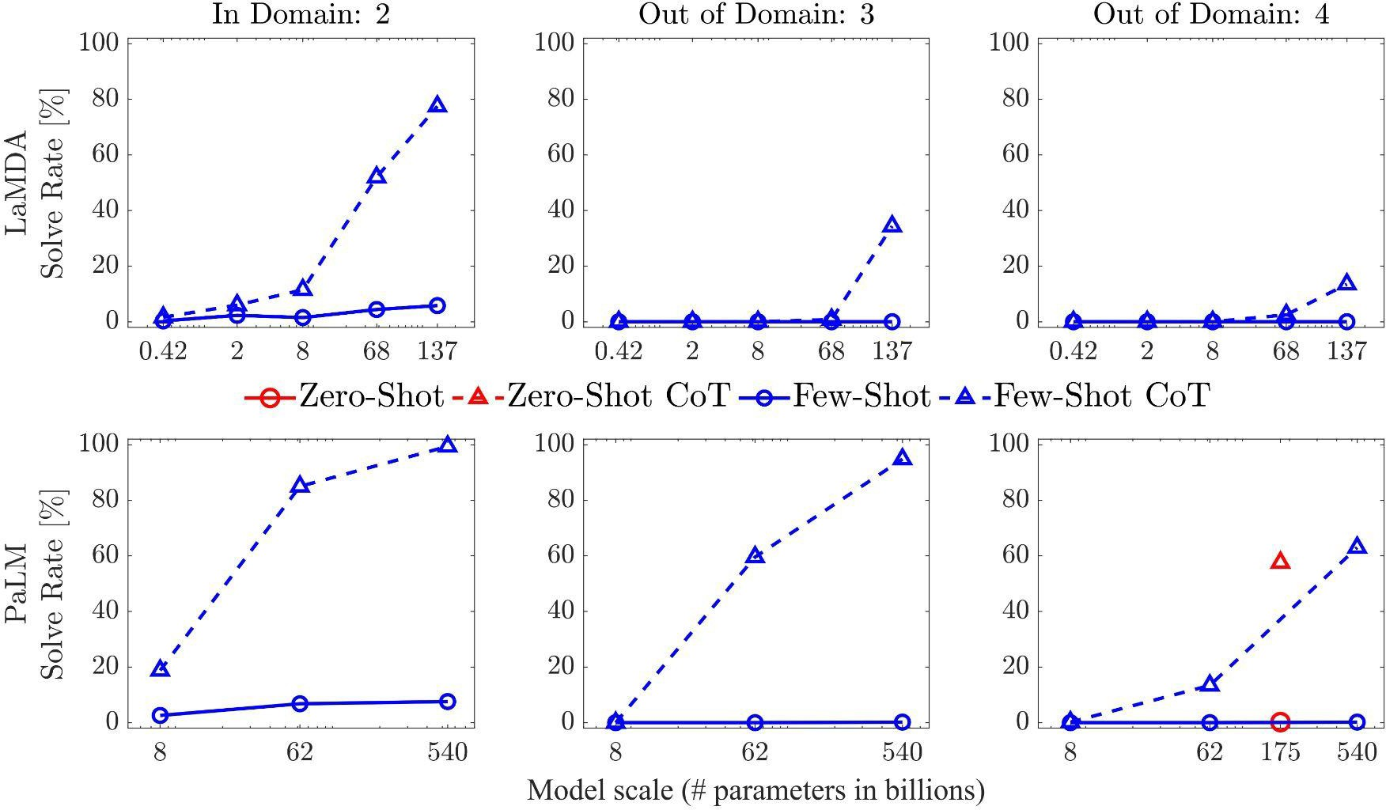
Symbolic Reasoning - Last Letter Concatenation
In-Domain
Take the last letters of the words in "Elon Musk" and concatenate them.
Out-of-Domain
Take the last letters of the words in "Johann Sebastian Bach" and concatenate them.
*Zero-Shot results use Instruct-GPT-3 175B text-davinci-002 model.

Slide 52
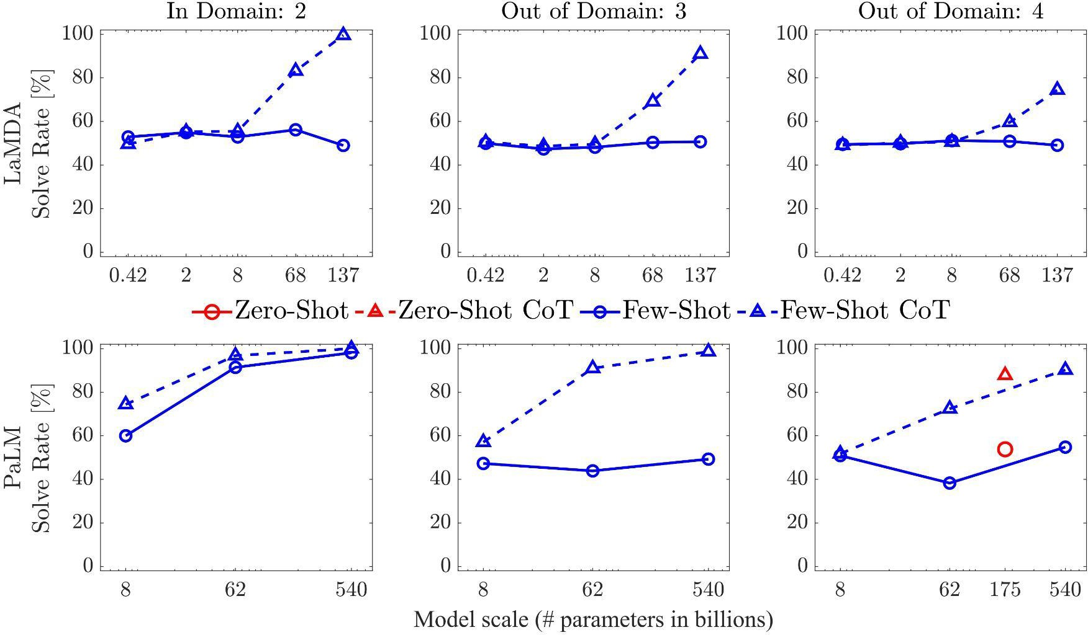
Symbolic Reasoning - Coin Flip
In-Domain
A coin is heads up. Tom does not flip the coin. Mike does not flip the coin. Is the coin still heads up?
Out-of-Domain
A coin is heads up. Tom does not flip the coin. Mike does not flip the coin. Jake flips the coin. Is the coin still heads up?
*Zero-Shot results use Instruct-GPT-3 175B text-davinci-002 model.

Slide 53
Symbolic Reasoning - Observations
Standard prompting fails out-of-domain tests for both tasks.

Slide 54
Symbolic Reasoning - Observations
Standard prompting fails out-of-domain tests for both tasks.
Both zero-shot and few-shot CoT promptings are emergent abilities of model scale.

Slide 55
Symbolic Reasoning - Observations
Standard prompting fails out-of-domain tests for both tasks.
Few-shot CoT prompting is emergent abilities of model scale.
CoT does not positively impact performance for small models, but start to yield performance gains when using models with more than ∼100B parameters for both in-domain and out-of-domain tests.

Slide 56
Symbolic Reasoning - Observations
Standard prompting fails out-of-domain tests for both tasks.
Few-shot CoT prompting is emergent abilities of model scale.
CoT does not positively impact performance for small models, but start to yield performance gains when using models with more than ∼100B parameters for both in-domain and out-of-domain tests.
Zero-shot CoT using Instruct-GPT-3 175B achieves the similar performance as few-shot
CoT in both tasks using 540B PaLM model.

Slide 57
Pre-Lecture Question 2
Q2: Wei et al., 2022 showed that CoT can improve out-of-domain performance. Can you state their results and why do you think it is the case (i.e., adding intermediate steps can improve robustness)?

Slide 58
Pre-Lecture Question 2
Q2: Wei et al., 2022 showed that CoT can improve out-of-domain performance. Can you state their results and why do you think it is the case (i.e., adding intermediate steps can improve robustness)?
While standard prompting fails out-of-domain tests for both tasks, large models with both zero-shot and few-shot CoT improve the performance of in-domain and out-of-domain tests. CoT prompt in this symbolic reasoning tasks really guides the LM to reason the process of mapping input to the output. Even if questions
are OOD in the sense of “how many words in the name” and “how many states to track”, the process of getting the output are still same, and can be resembled from exemplars. However, it is still unsure that CoT will improve other OOD scenarios with more complex reasoning processes.

Slide 59
Experiments CommonSense Reasoning

Slide 60
Commonsense Reasoning - Toy Problems
CSQA (Talmor et al., 2019)
Q: What home entertainment equipment requires cable?
Answer Choices: (a) radio shack (b) substation (c) television (d) cabinet
A: The answer is (c).
Sport Understanding
Q: Is the following sentence plausible? “Jamel Murray was perfect from the line.”
A: The answer is yes.
StrategyQA (Geva et al., 2021)
Q: Could Brooke Shields succeed at University of Pennsylvania?
A: The answer is yes.
Date Understanding
Q: 2015 is coming in 36 hours. What is the date one week from today in MM/DD/YYYY
A: So the answer is 01/05/2015.

Slide 61
Commonsense Reasoning - Toy Problems
SayCan Robot Planning
Locations = [counter, table, user, trash, bowl].
Objects = [7up, apple, kettle chips, tea, multigrain chips, coke, lime soda, jalapeno chips, rice chips, orange, grapefruit soda, pepsi, redbull, energy bar, sponge, water].
The robot can pick up items with pick(object) and put down items with put(object) as well as find objects or locations with find(). The robot can only understand the explicit locations and objects listed.
Human: How would you throw away a redbull?
Plan: 1. find(redbull), 2. pick(redbull), 3. find(trash), 4. put(redbull), 5. done().

Slide 62
Commonsense Reasoning - Toy Problems
SayCan Robot Planning
Locations = [counter, table, user, trash, bowl].
Objects = [7up, apple, kettle chips, tea, multigrain chips, coke, lime soda, jalapeno chips, rice chips, orange, grapefruit soda, pepsi, redbull, energy bar, sponge, water].
The robot can pick up items with pick(object) and put down items with put(object) as well as find objects or locations with find(). The robot can only understand the explicit locations and objects listed.
Human: How would you throw away a redbull?
Plan: 1. find(redbull), 2. pick(redbull), 3. find(trash), 4. put(redbull), 5. done().
These tasks not only require multi-steps reasoning, but also need priori knowledge to understand complex semantics.
62

Slide 63
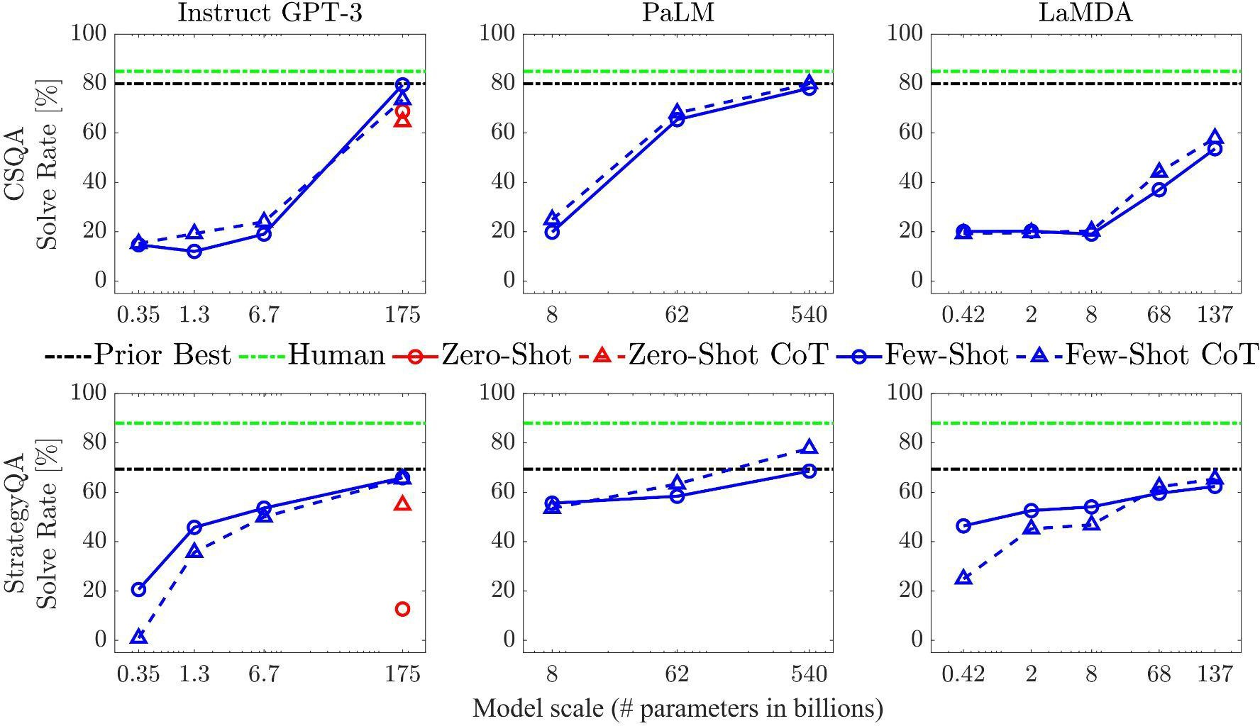
Commonsense Reasoning - Results

Slide 64
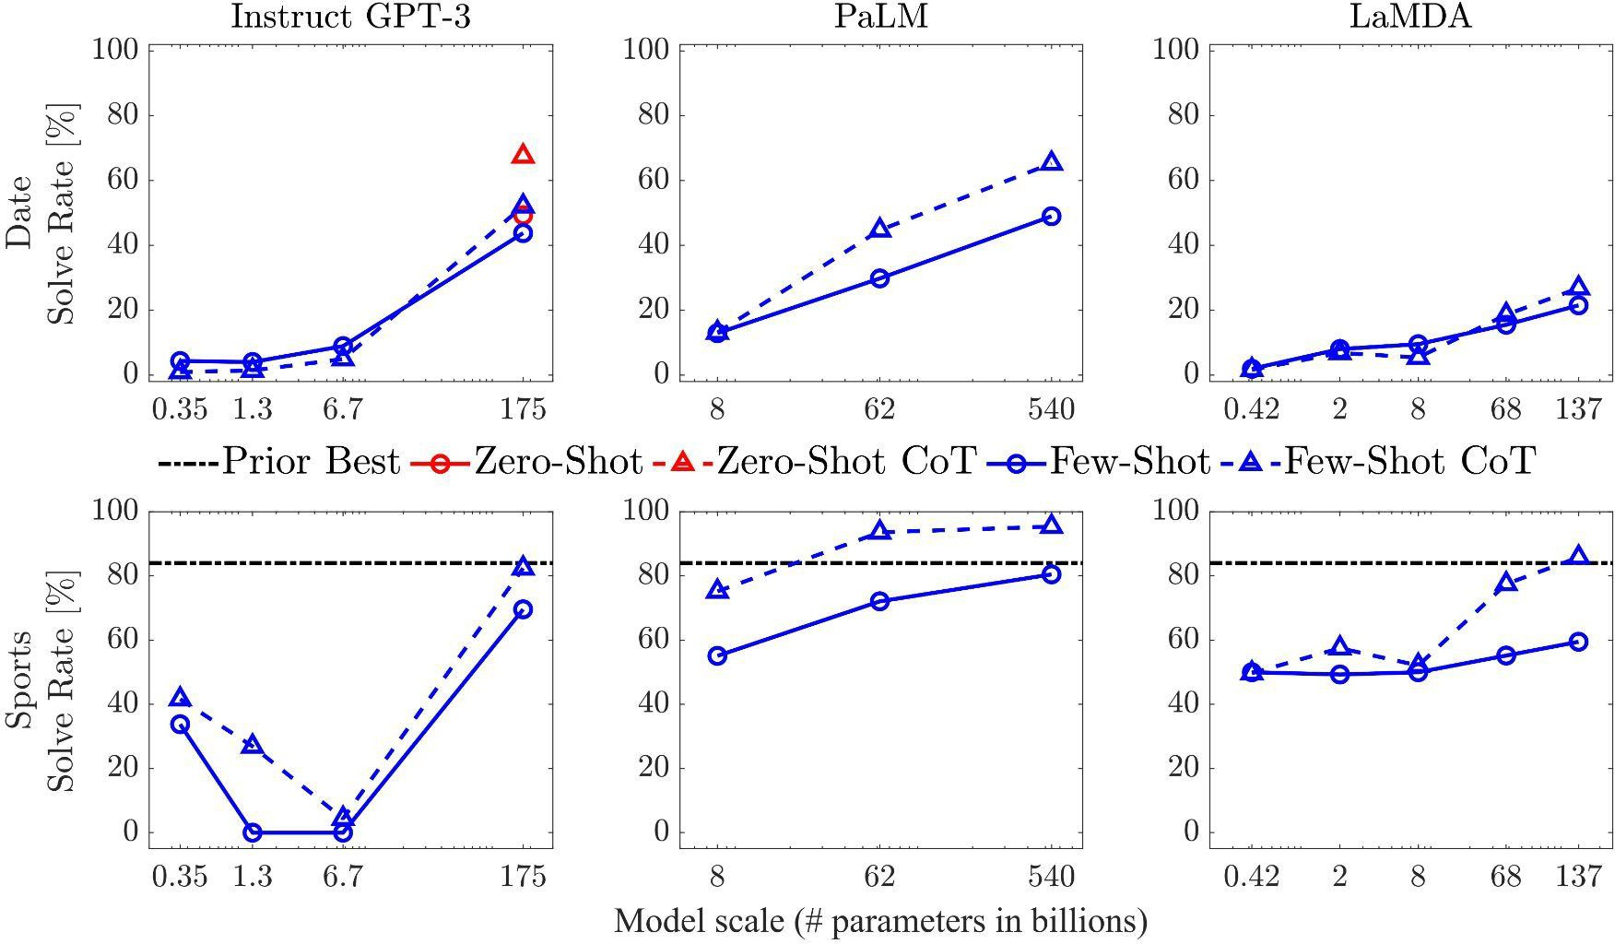
Commonsense Reasoning - Results

Slide 65
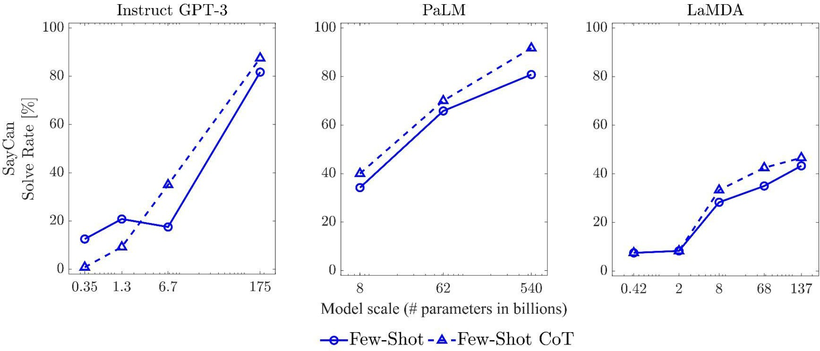
Commonsense Reasoning - Results

Slide 66
Commonsense Reasoning - Observations
For all tasks, scaling up model size improved the performance of standard prompting.

Slide 67
Commonsense Reasoning - Observations
For all tasks, scaling up model size improved the performance of standard prompting.
CoT prompting led to further gains, with improvements appearing to be largest for PaLM 540B.

Slide 68
Commonsense Reasoning - Observations
For all tasks, scaling up model size improved the performance of standard prompting.
CoT prompting led to further gains, with improvements appearing to be largest for PaLM 540B.
CoT has minimal benefits on CSQA and StrategyQA tasks.

Slide 69
Commonsense Reasoning - Observations
For all tasks, scaling up model size improved the performance of standard prompting.
CoT prompting led to further gains, with improvements appearing to be largest for PaLM 540B.
CoT has minimal benefits on CSQA and StrategyQA tasks.
Few-shot achieves better performance than Zero-shot CoT on 175B GPT-3 model for CSQA and Strategy QA tasks, but Zero-shot CoT shows significant improvement for Date understanding task.

Slide 70
Ablation Study - Variations of Few-Shot CoT
Change the types of CoT:
Equation only
5+6=11. The
answer is 11.

Slide 71
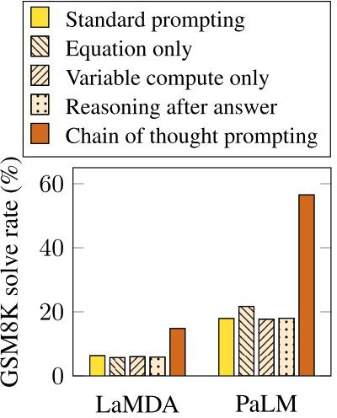
Ablation Study - Variations of Few-Shot CoT
Change the types of CoT:
Equation only
5+6=11. The
answer is 11.
Natural language in reasoning matters.
(Wei et al., 2022)
71

Slide 72
Ablation Study - Variations of Few-Shot CoT
Change the types of CoT:
Variable compute only
…………………
…………….. The answer is 11.

Slide 73
Ablation Study - Variations of Few-Shot CoT
Change the types of CoT:
Variable compute only
…………………
…………….. The answer is 11.
More intermediate computation does not help with the final answer.
(Wei et al., 2022)

Slide 74
Ablation Study - Variations of Few-Shot CoT
Change the types of CoT:
Reasoning after answer
The answer is 11. Roger started with 5 balls. 2 cans of 3 tennis balls each is 6 tennis balls. 5 +
6 = 11.

Slide 75
Ablation Study - Variations of Few-Shot CoT
Change the types of CoT:
Reasoning after answer
The answer is 11. Roger started with 5 balls. 2 cans of 3 tennis balls each is 6 tennis balls. 5 +
6 = 11.
CoT is not just activating knowledge seen in pre-training.
(Wei et al., 2022)

Slide 76
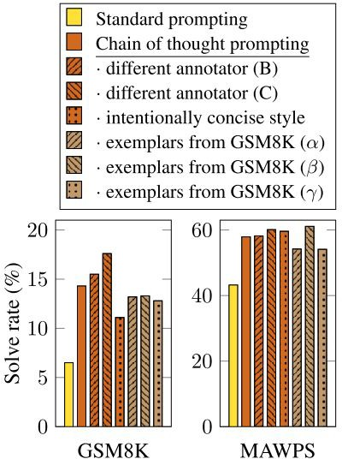
Ablation Study - Robustness (Style of Exemplar)
Change the style of exemplar in few-shot CoT:
(Wei et al., 2022)
Results for few-shot LaMDA 137B on two AR tasks: have variance, but CoT still outperforms standard prompting, robust against linguistic styles, different exemplars.
76

Slide 77
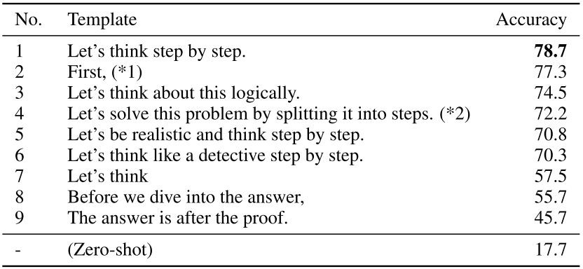
Ablation Study - Robustness (Trigger Sentence)
Change the template (trigger sentence) in
zero-shot CoT:
(Kojima et al., 2022)
Results for zero-shot GPT3 (davinci-002) 175B on MultiArith AR task: different templates encourage the model to express reasoning quite differently
77

Slide 78
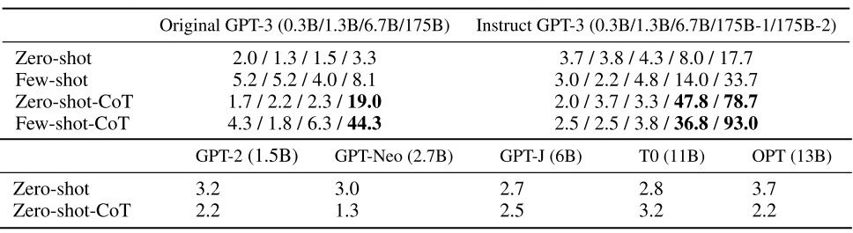
Ablation Study - Model Size
Change the model sizes in CoT prompting:
(Kojima et al., 2022)
Results on MultiArith AR task with different model sizes:
Larger model, better reasoning
CoT is effective only for larger models
Few-shot better than zero-shot
Instruct GPT-3 is much better than original GPT-3
78

Slide 79
Pre-Lecture Question 1
Q1: Describe how the two approaches from (Wei et al., 2022) and (Kojima et al., 2022) are different. Which one do you think is a more viable solution in terms of cost, performance and stability?
Wei's work uses few-shot setting with several demonstration examples required, and the CoT annotations need to be provided for each example, while Kojima's work uses LLM to generate the CoT with the two-stage prompting and no longer requires the annotated examples.
For most of benchmarks we have seen, few-shot CoT has better performance than zero-shot CoT, while zero-shot CoT does not require human annotations, which can be costly.
Although there is no direct comparison between zero-shot and few-shot CoT on stability, few-shot seems to be more robust as its performance does not vary significantly when changing the prompt annotations. On the other hand, zero-shot CoT has significant performance variance with different trigger sentences.
79

Slide 80
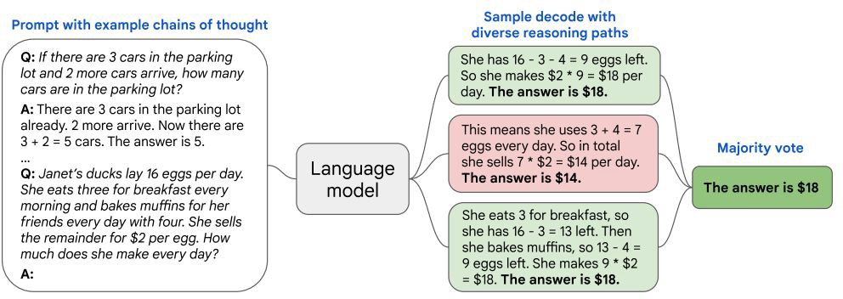
More Advances - Self-Consistency
Change greedy decode (single-path) to self-consistency (multi-path) in few-shot CoT:
Wang, Xuezhi, et al. "Self-consistency improves chain of thought reasoning in language models." arXiv preprint arXiv:2203.11171 (2022).

Slide 81
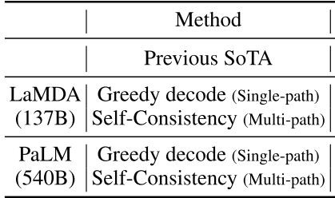
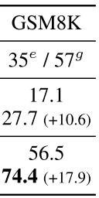
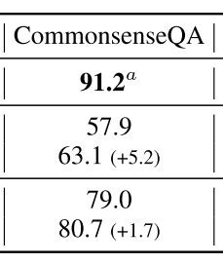
More Advances - Self-Consistency
Showcase results on AR, CR tasks:
Wang, Xuezhi, et al. "Self-consistency improves chain of thought reasoning in language models." arXiv preprint arXiv:2203.11171 (2022).

Slide 82
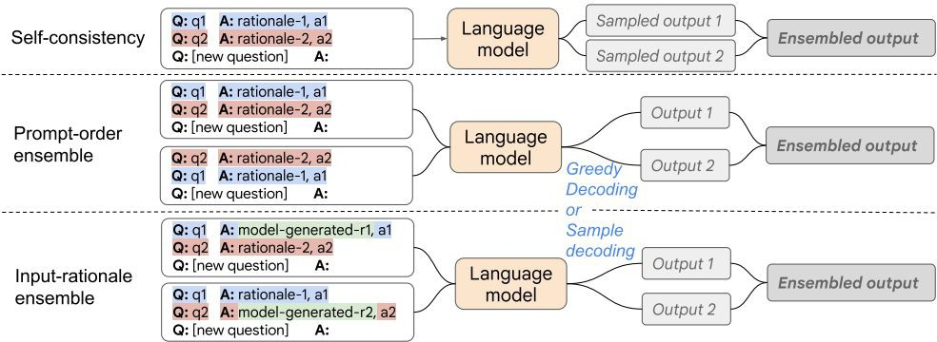
More Advances - Input-Rational Ensemble
Use model-generated rationale in few-shot CoT:
Wang, Xuezhi, et al. "Rationale-Augmented Ensembles in Language Models." arXiv preprint arXiv:2207.00747 (2022).
82

Slide 83
More Advances - Input-Rational Ensemble
Showcase performance for AR reasoning tasks (PaLM-540B):
 | GSM8K
Standard-prompting | 17.9
Few-shot CoT (Wei et al. 2022) | 56.5
Zero-shot CoT (Kojima et al. 2022) | 43.0
Self-consistency (Wang et al. 2022) | 74.4
Prompt-order ensemble | 75.4
Input-rationale ensemble | 73.8
Performance improvement on reasoning is great over previous CoT, but not significant against self-consistency,
83

Slide 84
Pre-Lecture Question 3 and Discussion
Q3: Do you think the CoT method can be useful to other NLP tasks that we have seen in the previous lectures (standard NLP tasks that are beyond the arithmetic/logic reasoning tasks that these papers evaluated on)? Do you have any ideas about how we can collect the CoT data?

Slide 85
Reference
Wei, Jason, et al. "Chain of thought prompting elicits reasoning in large language models." arXiv preprint arXiv:2201.11903 (2022).
Kojima, Takeshi, et al. "Large Language Models are Zero-Shot Reasoners." arXiv preprint arXiv:2205.11916 (2022).
Cobbe, Karl, et al. "Training verifiers to solve math word problems." arXiv preprint arXiv:2110.14168 (2021).
Patel, Arkil, Satwik Bhattamishra, and Navin Goyal. "Are NLP Models really able to Solve Simple Math Word Problems?." NAACL 2021.
Miao, Shen-Yun, Chao-Chun Liang, and Keh-Yih Su. "A diverse corpus for evaluating and developing English math word problem solvers." ACL 2020 (2020).
Koncel-Kedziorski, Rik, et al. "MAWPS: A math word problem repository." NAACL 2016.
Ling, Wang, et al. "Program induction by rationale generation: Learning to solve and explain algebraic word problems."
arXiv preprint arXiv:1705.04146 (2017).
Alon Talmor, Jonathan Herzig, Nicholas Lourie, and Jonathan Berant. 2019. CommonsenseQA: A question answering challenge targeting commonsense knowledge. NAACL.
Ahn, Michael, et al. "Do as i can, not as i say: Grounding language in robotic affordances." arXiv preprint arXiv:2204.01691 (2022).
Wang, Xuezhi, et al. "Self-consistency improves chain of thought reasoning in language models." arXiv preprint arXiv:2203.11171 (2022).
Wang, Xuezhi, et al. "Rationale-Augmented Ensembles in Language Models." arXiv preprint arXiv:2207.00747 (2022).

Slide 86
Discussion
(This part will not be in presentation)

Slide 87
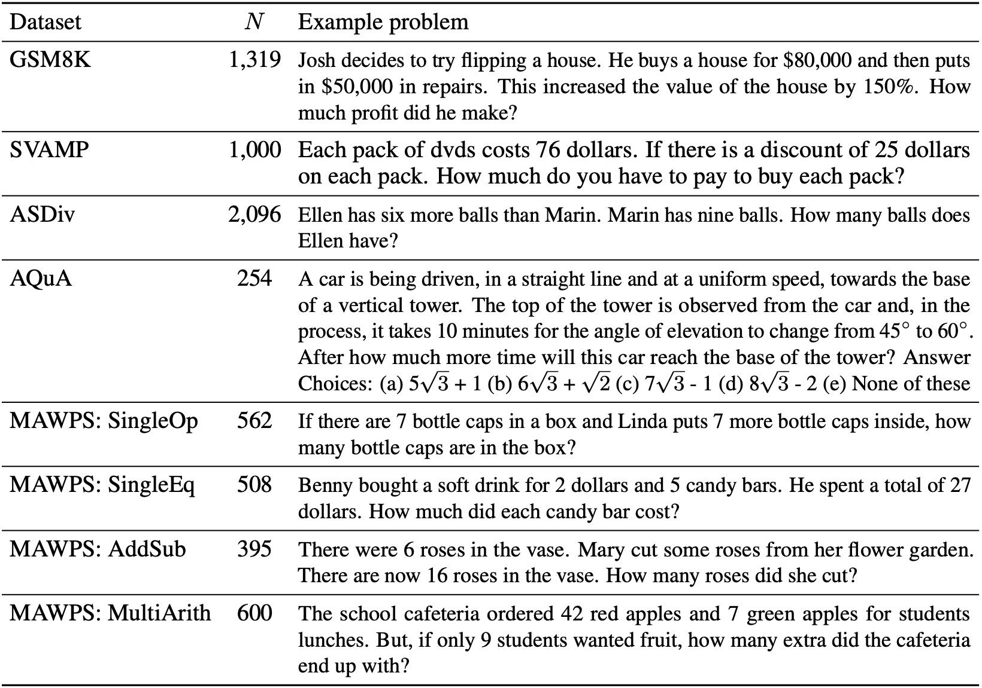
Summary of Arithmetic Reasoning Benchmark
Summary of math arithmetic reasoning benchmarks. N: number of evaluation examples (Wei, et al. 2022)

Slide 88
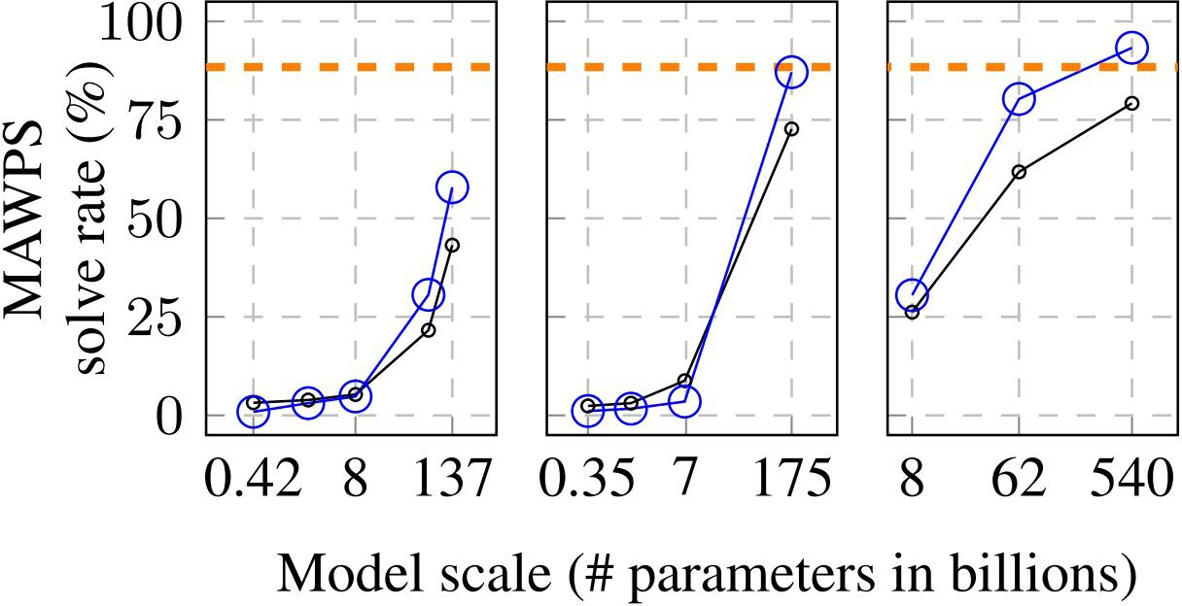
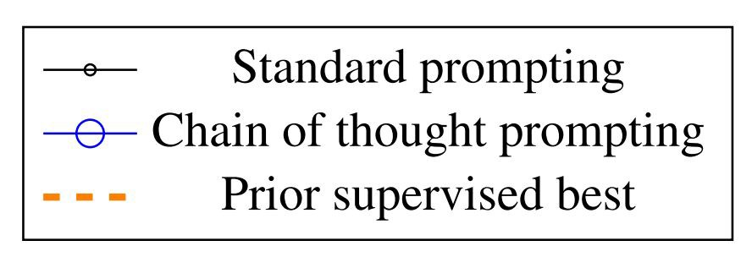
Arithmetic Reasoning - Few-Shot CoT MAWPS Results
LaMDA GPT PaLM

Slide 89
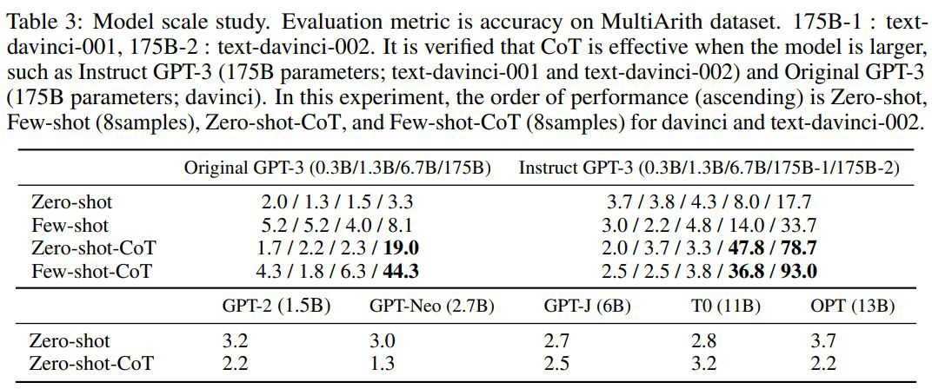
Arithmetic Reasoning - Zero-Shot CoT Additional Results

Slide 90
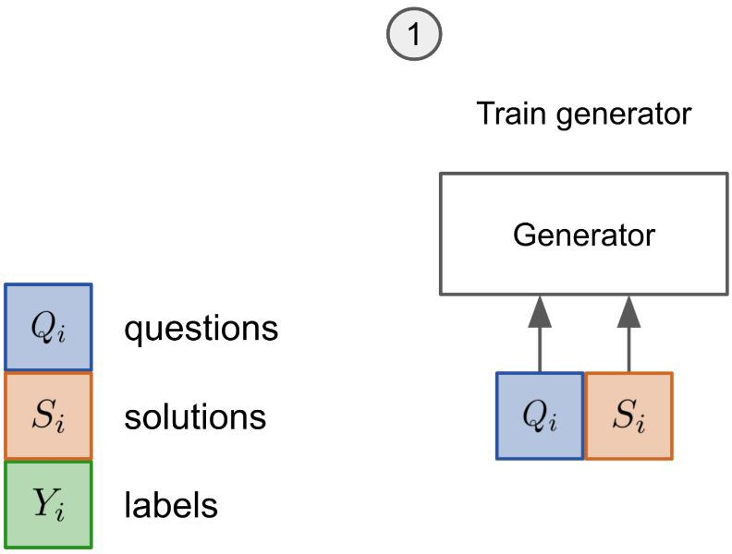
Prior Best – Fine-tuning + Verification
GPT-3
1. Fine-tuned 2 epoch on training set.

Slide 91
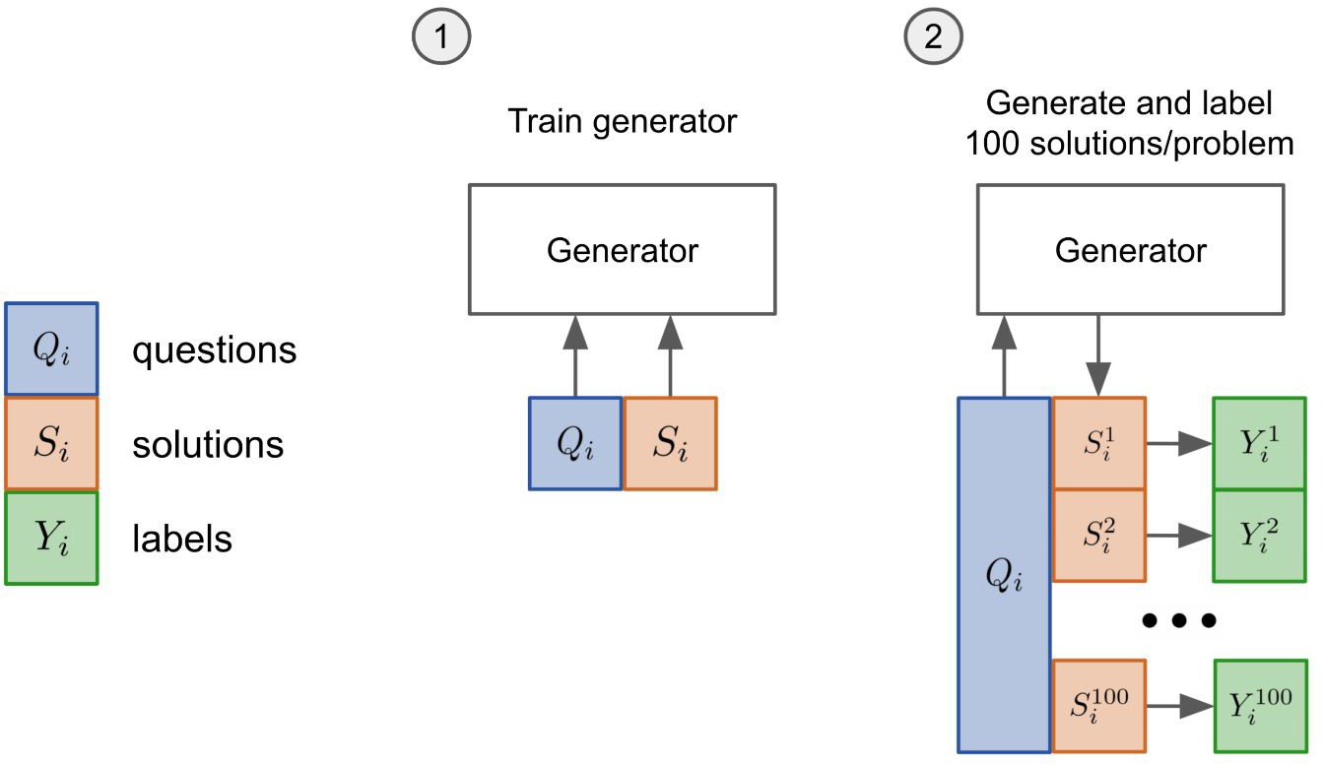
Prior Best – Fine-tuning + Verification
GPT-3
Finding the one with the highest score
1. Fine-tuned 2 epoch on training set.

Slide 92
Prior Best – Fine-tuning + Verification
GPT-3
Fine-tuned 2 epoch on training set.
Sample 100 solutions from the generator for each training problem and label each solution as correct or incorrect.
Correct or Incorrect
(Cobbe et al. 2021)
92

Slide 93
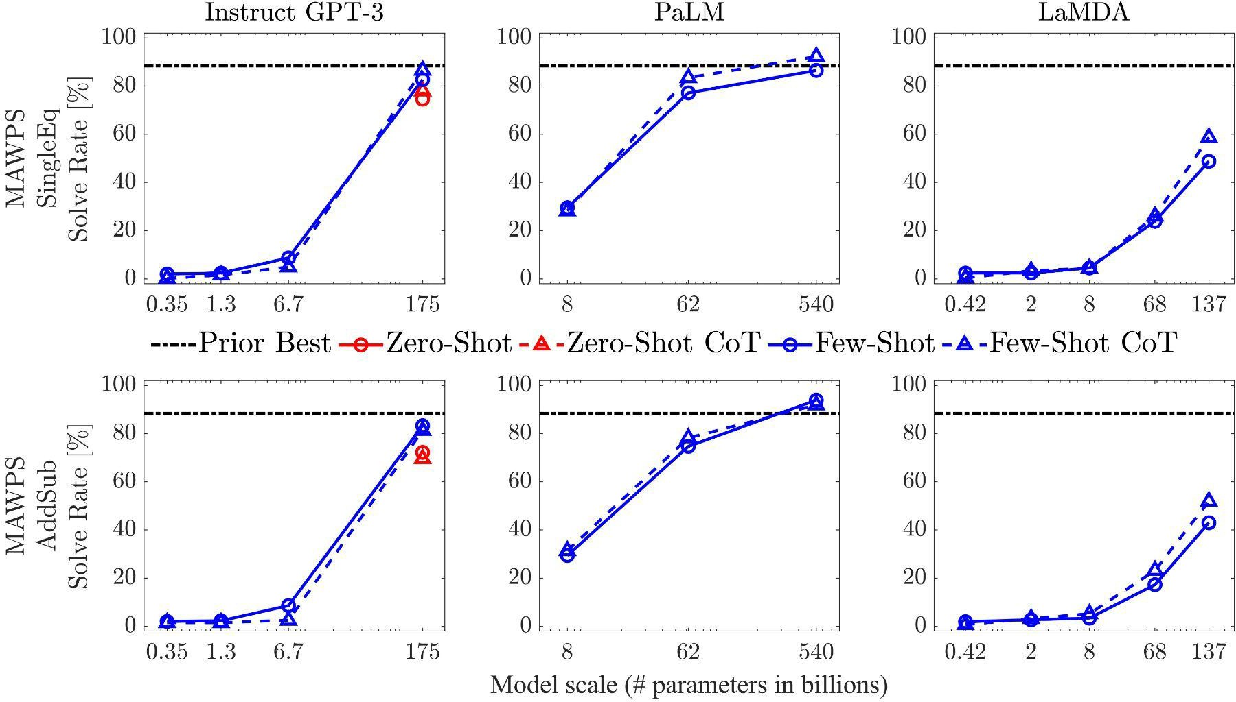
Arithmetic Reasoning - Results
MAWPS - SingleEq
If there are 7 bottle caps in a box and Linda puts 7 more bottle caps inside, how many bottle caps are in the box?
MAWPS - AddSub
There were 6 roses in the vase. Mary cut some roses from her flower garden. There are now 16 roses in the vase. How many roses did she cut?

Slide 94
Commonsense Reasoning - CSQA CoT Prompt
CSQA (Talmor et al., 2019)
Q: What home entertainment equipment requires cable?
Answer Choices: (a) radio shack (b) substation (c) television (d) cabinet
A: The answer must require cable. Of the above choices, only television requires cable. The answer is (c).
7 exemplars from training dataset

Slide 95
Commonsense Reasoning - CSQA CoT Prompt
CSQA (Talmor et al., 2019)
Q: What home entertainment equipment requires cable?
Answer Choices: (a) radio shack (b) substation (c) television (d) cabinet
A: The answer must require cable. Of the above choices, only television requires cable. The answer is (c).
7 exemplars from training dataset
Manually composed intermediate reasoning with strict format:
The answer must . Of the above choices, only .

Slide 96
Commonsense Reasoning - Strategy QA CoT Prompt
StrategyQA (Geva et al., 2021)
Q: Could Brooke Shields succeed at University of Pennsylvania?
A: Brooke Shields went to Princeton University. Princeton University is about as academically rigorous as the University of Pennsylvania. Thus, Brooke Shields could also succeed at the University of Pennsylvania.The answer is yes.
6 exemplars from training dataset

Slide 97
Commonsense Reasoning - Strategy QA CoT Prompt
StrategyQA (Geva et al., 2021)
Q: Could Brooke Shields succeed at University of Pennsylvania?
A: Brooke Shields went to Princeton University. Princeton University is about as academically rigorous as the University of Pennsylvania. Thus, Brooke Shields could also succeed at the University of Pennsylvania.The answer is yes.
6 exemplars from training dataset
Manually composed intermediate reasoning with flexible format

Slide 98
Commonsense Reasoning - Strategy QA CoT Prompt
StrategyQA (Geva et al., 2021)
Q: Could Brooke Shields succeed at University of Pennsylvania?
A: Brooke Shields went to Princeton University. Princeton University is about as academically rigorous as the University of Pennsylvania. Thus, Brooke Shields could also succeed at the University of Pennsylvania.The answer is yes.
StrategyQA (Geva et al., 2021)
Q: Yes or no: Is it common to see frost during some college commencements?
A: College commencement ceremonies can happen in December, May, and June. December is in the winter, so there can be frost. Thus, there could be frost at some commencements. The answer is yes.

Slide 99
Commonsense Reasoning - CoT Prompt
Date Understanding
Q: 2015 is coming in 36 hours. What is the date one week from today in MM/DD/YYYY
A: If 2015 is coming in 36 hours, then it is coming in 2 days. 2 days before 01/01/2015 is 12/30/2014, so today is 12/30/2014. So one week from today will be 01/05/2015. So the answer is 01/05/2015.
Sport Understanding
Q: Is the following sentence plausible? “Jamel Murray was perfect from the line.”
A: Jamal Murray is a basketball player. Being perfect from the line is part of basketball. The answer is yes.
6 exemplars for Date Understanding
8 exemplars for Sport Understanding

Slide 100
Commonsense Reasoning - CoT Prompt
SayCan Robot Planning (Ahn et al., 2022)
Locations = [counter, table, user, trash, bowl].
Objects = [7up, apple, kettle chips, tea, multigrain chips, coke, lime soda, jalapeno chips, rice chips, orange, grapefruit soda, pepsi, redbull, energy bar, sponge, water].
The robot can pick up items with pick(object) and put down items with put(object) as well as find objects or locations with find(). The robot can only understand the explicit locations and objects listed.
Human: How would you throw away a redbull?
Explanation: The user has asked me to throw away the redbull, I will move it to the trash. Plan: 1. find(redbull), 2. pick(redbull), 3. find(trash), 4. put(redbull), 5. done().
7 exemplars for SayCan
100

Slide 101
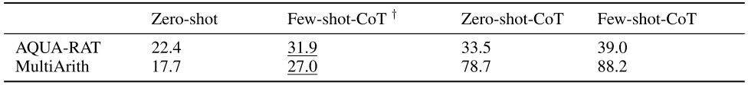
Ablation Study - Robustness (Example Distribution)
Change the examples in few-shot CoT:
Change examples from in-domain to out-of-domain!
Results for few-shot on two AR tasks with examples† from a CR task (CommonsenseQA): across-domain examples with the same format have minor performance degradation.
101

